Slide 1

TED Talks Final
—— 2019.6.13

Slide 2
Task Assignment
Timeline
Combine Three Parts
All of the group members
5 ~ 6 Days
Application
Build a
Web Page Front-end
Sui Mingben, Wang Yibo
5 ~ 6 Days
Process Data
Wang Zhihang
5 ~ 7 Days
Develop a
Development Plan
All of the group members
3 ~ 4 Days
Build a
Web Page Background
Wang Zhihang
5 ~ 6 Days
GO
Machine Learning
Hou Qinhan
5 ~ 7 Days

Slide 3
Subtitles
Step 1 - Initialization & Diagrams
Step 2 - Data Analysis
Step 3 - Machine learning
Step 4 - Architecture & Test
5 - Conclusion

Slide 4
Step 1
Initialization & Diagram

Slide 5
Initialization
We have chosen a dataset containing information about all audio-video recordings of TED Talks uploaded to the oﬃcial TED.com website until September 21st, 2017.
We want to use this dataset to start a project of data mining, ﬁnding the relationship of views, number of comments, main topics, languages and areas. In addition, we may ﬁnd a popular topics trend from last ten years and predict what will be discussed at next ﬁve years.

Slide 6
Initialization
We tend to develop an application recommending TED Talks and seeing the popular topics trend between any time period.
After register and log in our web application, users would watch the recommendation video from our application, after watching, they may give some advice like ‘I like it’ or ‘I do not like it’. If they do not like it, the system will recommend a video that he is more likely to like.

Slide 7
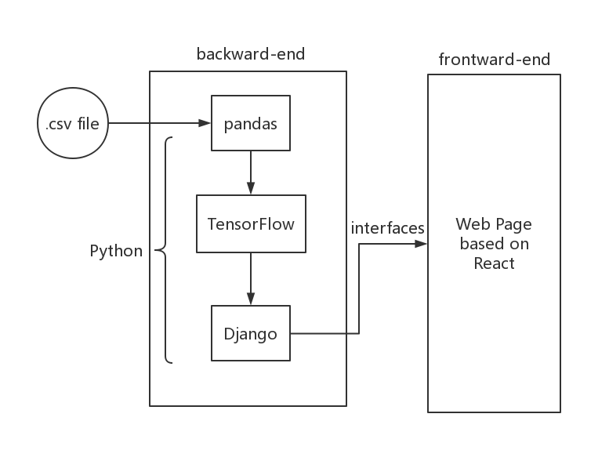
Initialization
First of all, we use a Python data processing framework called Pandas to extract the data from .csv file to a specific data format for TensorFlow.
After getting the data, we use TensorFlow to train our model and get a prediction from our data.
The result of TensorFlow will be organized by using Django and then will be sent to the web page by prescribed interfaces.

Slide 8
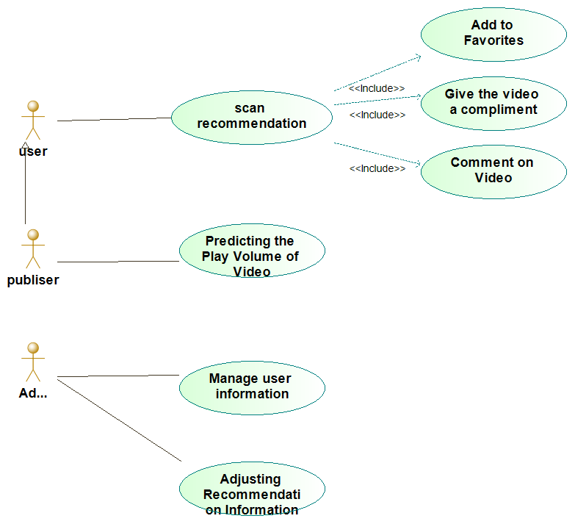
Use Case Diagram
User
Publisher
Administrator

Slide 9
Timing Diagram
This timing diagram shows the dynamic collaboration between multiple objects by describing the chronological order in which messages are sent between objects. It can represent the order of behavior of the use cases. When a use case behavior is executed, each of the messages corresponds to a class operation or a trigger event in the state machine that causes the conversion.

Slide 10
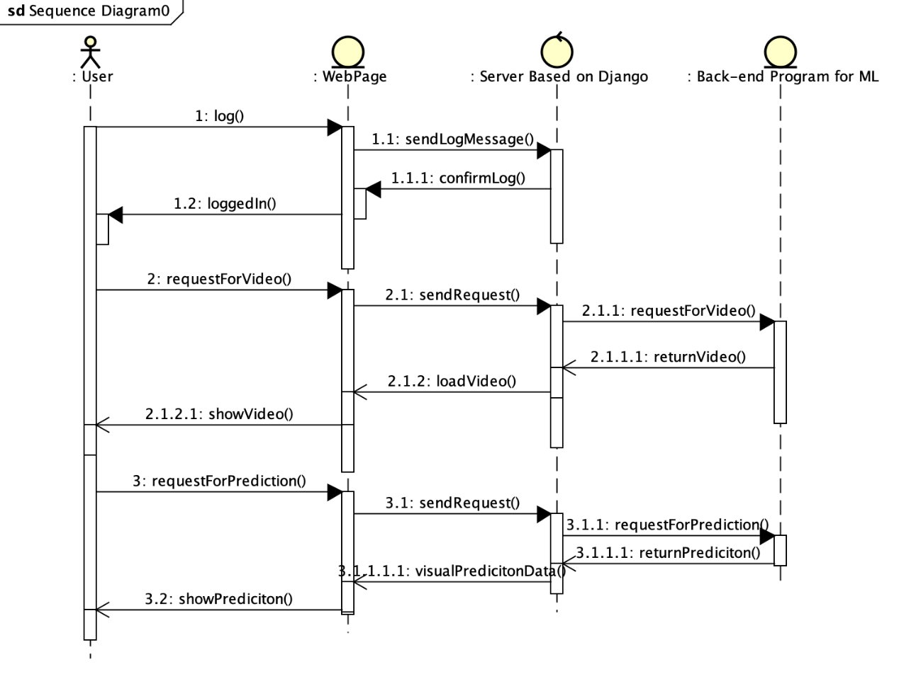
Sequence Diagram
This diagram shows a high-level invocation in all the project. There are three parts of our project, including front-end web page, back-end server based on Django and Python program processing all the data.

Slide 11
Step 2
Data Analysis

Slide 12
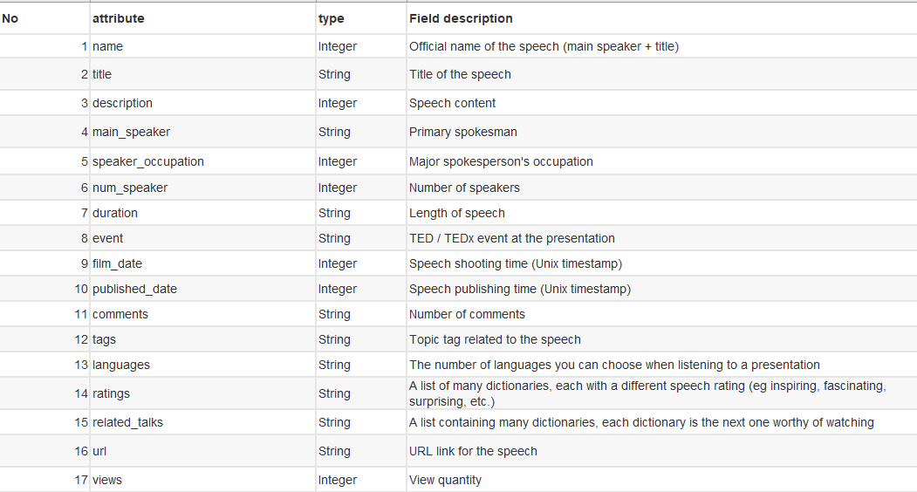
DATASET
The data set is a
2540 * 17 data set.
This diagram shows the meaning of every columns.

Slide 13
Data Clearing and Transformation
What we have done:
Import .csv file into .py file as Dataframe using Panda.
pd.read_csv( )
Clean data-missed record & Drop useless column.
df.dropna & df.drop & df.rename
Change data format :
from ‘str’ to ‘float64’ & from ‘str’ to ‘dictionary’
pd.to_numeric & .apply(lambda x: ast.literal_eval(x))

Slide 14
Data Clearing and Transformation
In order to analyze the relationship between theme and views, we need to separate each individual theme from the tag array.
raw
processed

Slide 15
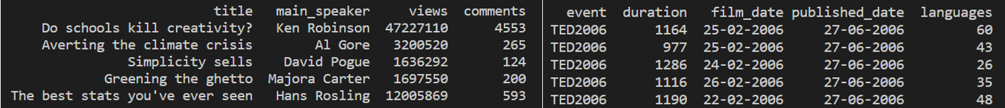
3. Data Clearing and Transformation
Several useful columns such as title main speaker views comments event are retained

Slide 16
RELATION
As we can see from the heat map, the comments attribute has the most relevance to views, followed by languages.

Slide 17
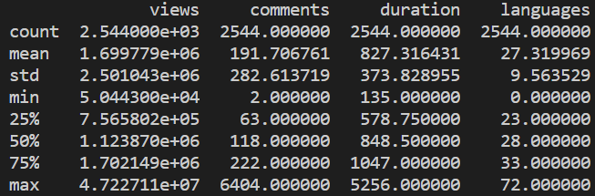
OVERALL ANALYSIS
The maximum viewing volume is 47,227,110
The minimum is 50,443
The average is 1,699,779
Undoubtably,
every video is very popular.

Slide 18
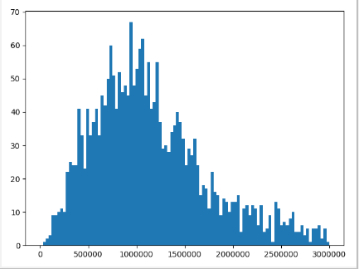
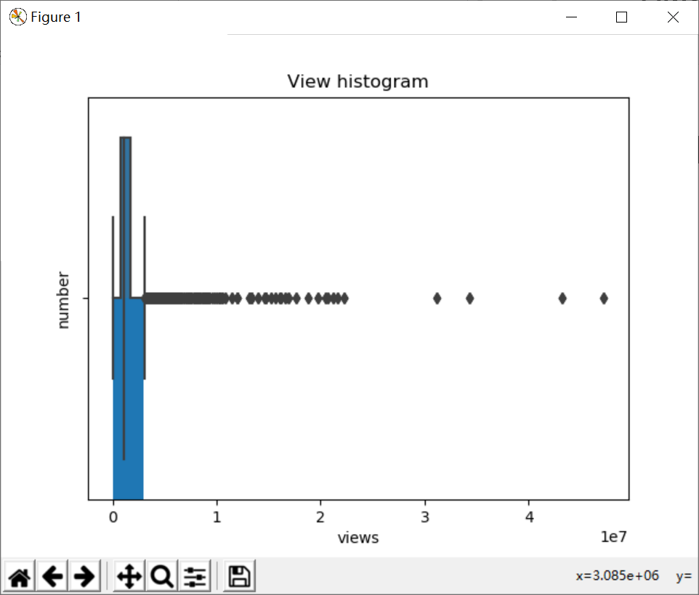
VIEW VOLUME

Slide 19
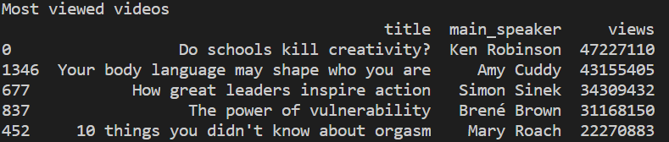
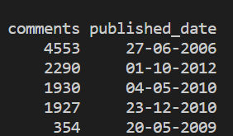
MOST VIEWED 5 TALKS

Slide 20
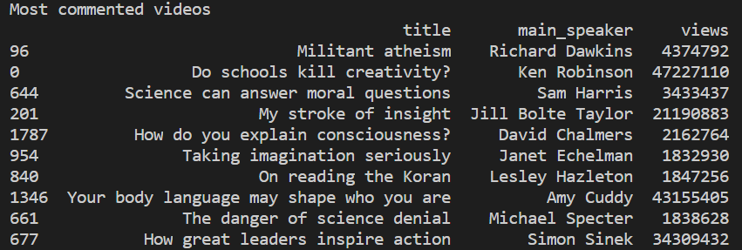
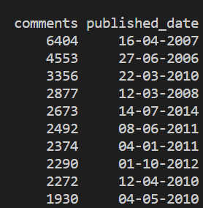
MOST COMMENTED 10 TALKS

Slide 21
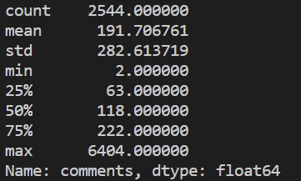
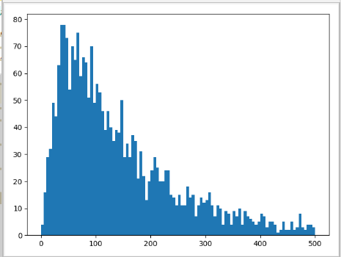
Most commented talks
The maximum comments is 6404
The minimum is 2
The average is 192
There is a big difference between them.

Slide 22
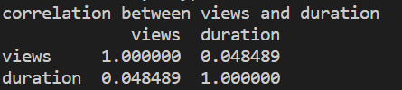
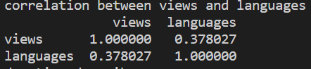
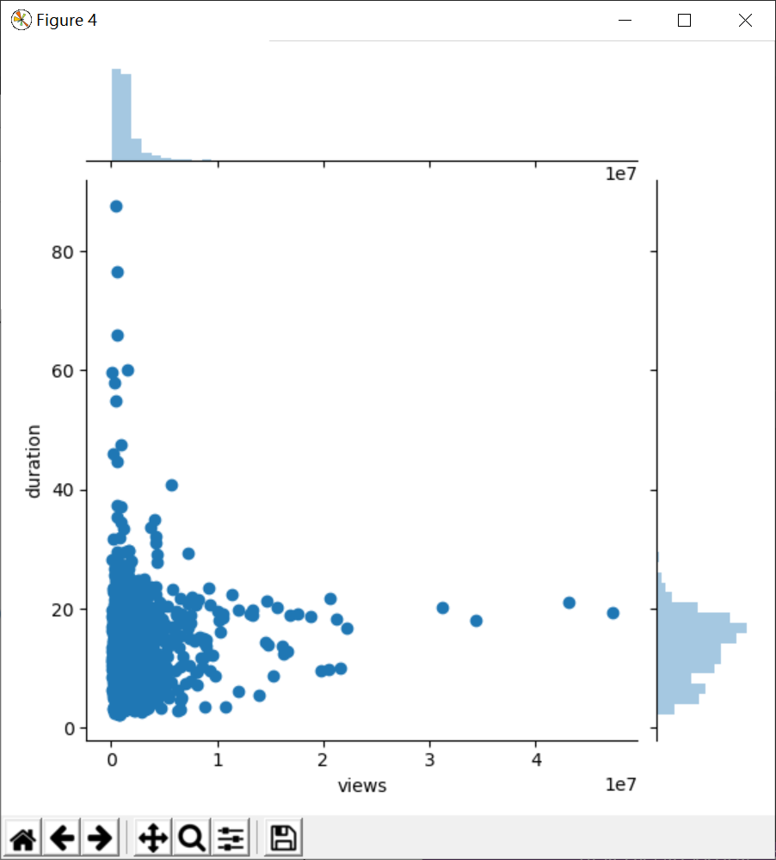
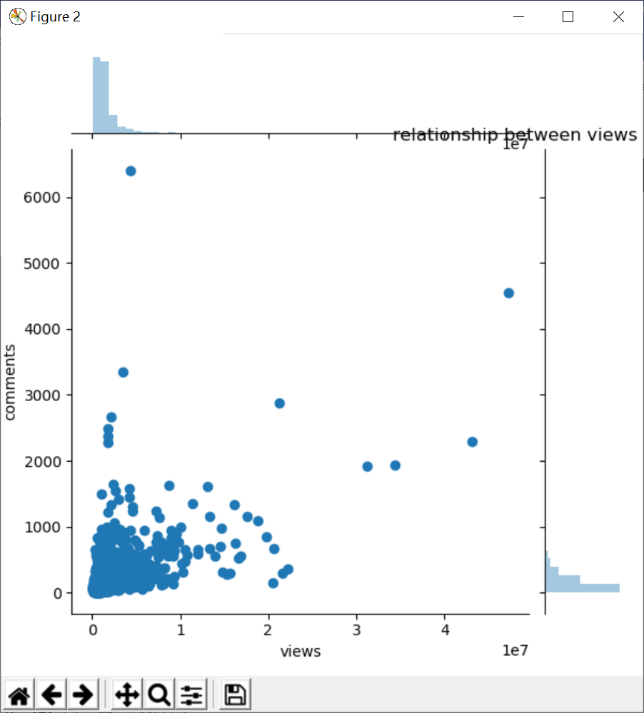
RELATIONS

Slide 23
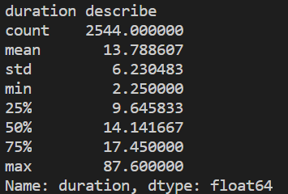
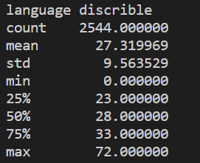
DURATION & LANGUAGE

Slide 24
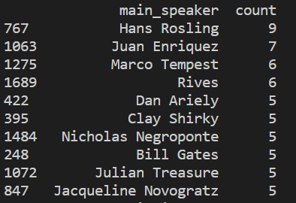
PERSONS SPEAK MOST

Slide 25
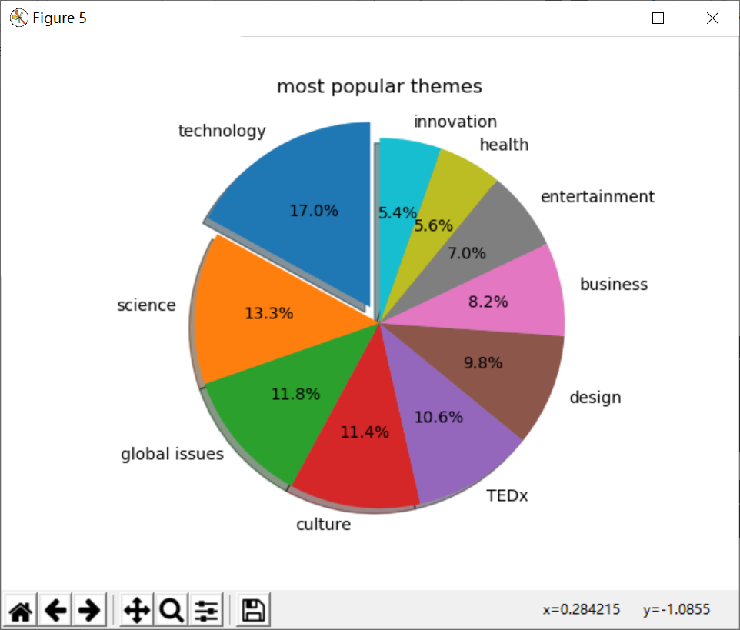
MOST POPULAR THEMES
Technology,
science,
global issues
are the most popular themes

Slide 26
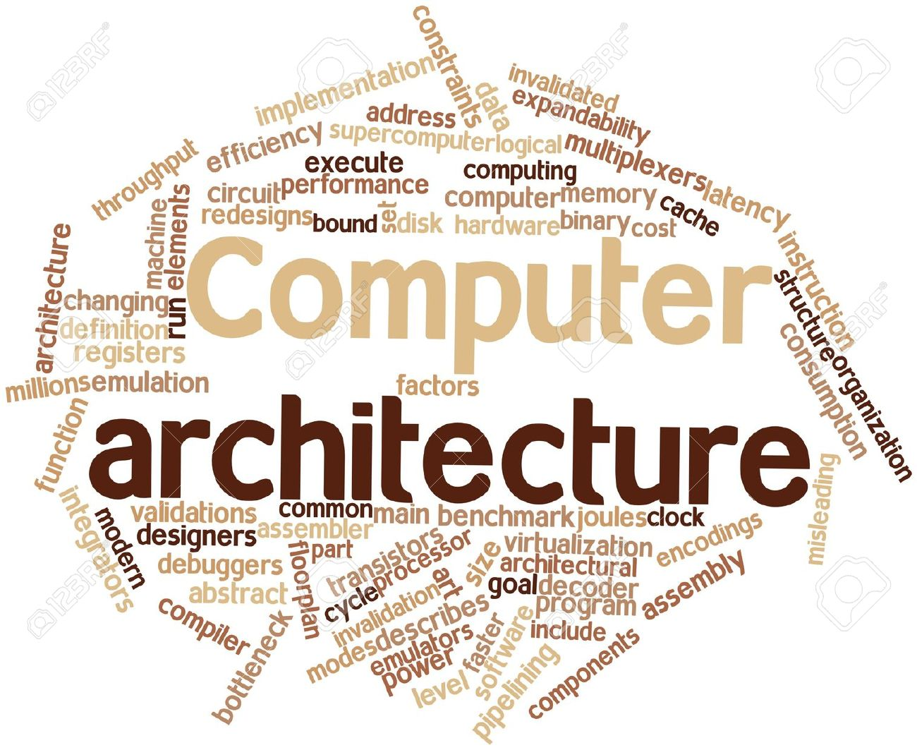


Slide 27
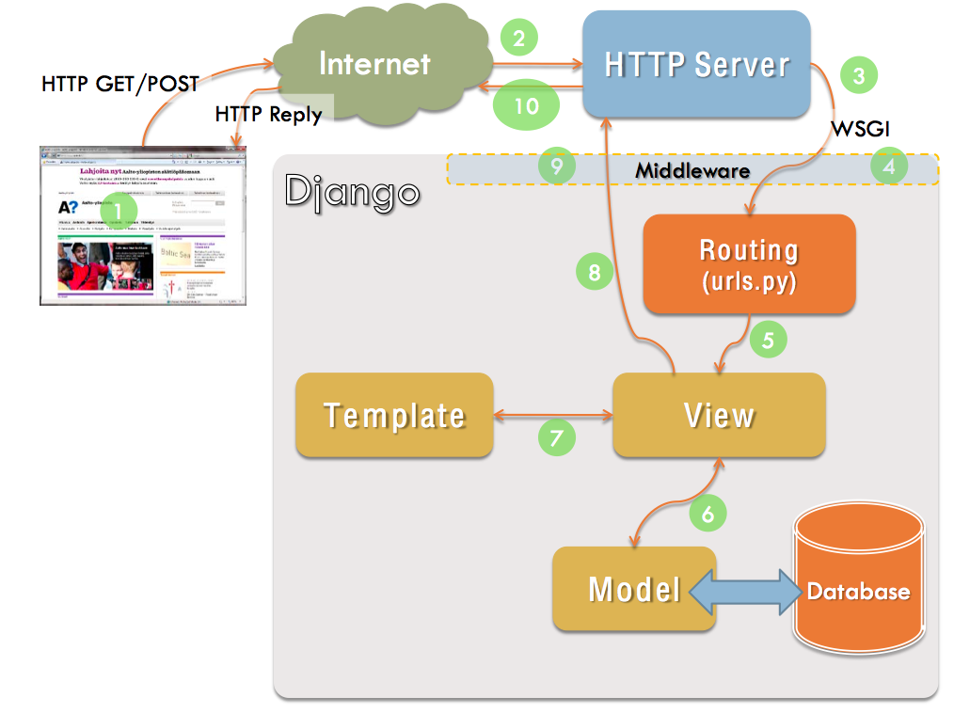
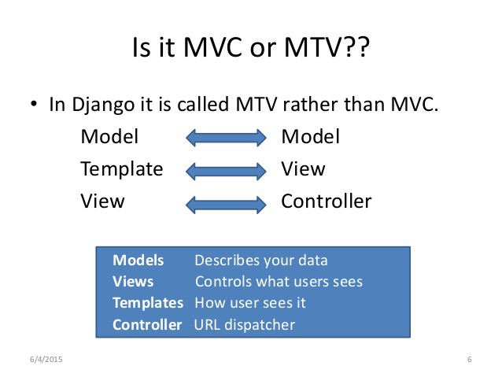

Slide 28
Some Functions
Recommend.
Based on K-means algorithm, we set 10 or 15 topics as the kernel, separating videos into several parts, and we will recommend the best suitable videos to different audience with different interested topics. In our K-means algorithm, we use TF-IDF to calculate differences between videos.
2. Prediction.
Based on Regression algorithm, we use duration, speakers‘ occupation and main topic of the video as the input value, and set ‘views’ as the target value, then we may get an model to predict number of views of an given information video.
3. Visualization
After using python to generate some diagrams, we wrote a report about the data analysis and ML. We want to put it on the web page to show.

Slide 29

1.Recommadation ->url
2.Visualization ->plots, description
3.ML prediction ->result

Slide 30
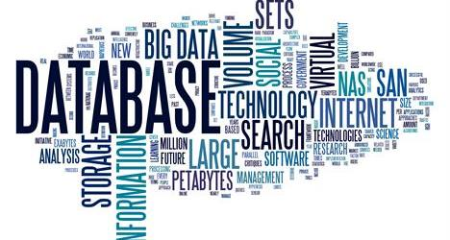
User
Id:int(main key)
Name:string
Password:string
Perferance:string
Nickname:string
isSuper:boolean
Movie
Id:int(main key)
Title:string
Tags:string
url:string

Slide 31
Step 3
Machine learning

Slide 32
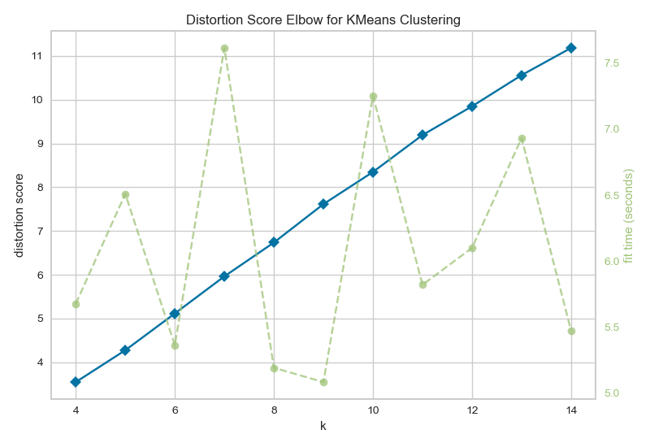
3.1 UNSUPERVISED LEARNING - CLUSTERING
Find the Most Suitable K
-
In order to cluster using the KMeans method, we need to know a suitable K value in advance to decide how many clusters to divide the data into. We use the Elbow Method to calculate the K values in the range 4 - 15 to get the Distortion Score and Fit Time for each K value. For the same K value, we need the Distortion Score to be as small as possible and the Fit Time to be as low as possible, so we can choose 9 as the number of clusters.

Slide 33
3.1 UNSUPERVISED LEARNING - CLUSTERING
Do the Clustering &
Calculate the Silhouette Value
-
Silhouette Value is a factor used to detect how well KMeans are classified. We can see through visualization that among the data items classified into 9 categories, the data classified into the 6th item is more accurate, and the value of the 1th type data has a larger negative number, and the result is not good. Overall, the clustering results are acceptable.

Slide 34
3.1 UNSUPERVISED LEARNING - CLUSTERING
Inter-cluster Distance Maps
-
Inter-cluster distance maps display an embedding of the cluster centers in 2 dimensions with the distance to other centers preserved. E.g. the closer to centers are in the visualization, the closer they are in the original feature space. The clusters are sized according to a scoring metric.
Note however, that because two clusters overlap in the 2D space, it does not imply that they overlap in the original feature space.

Slide 35
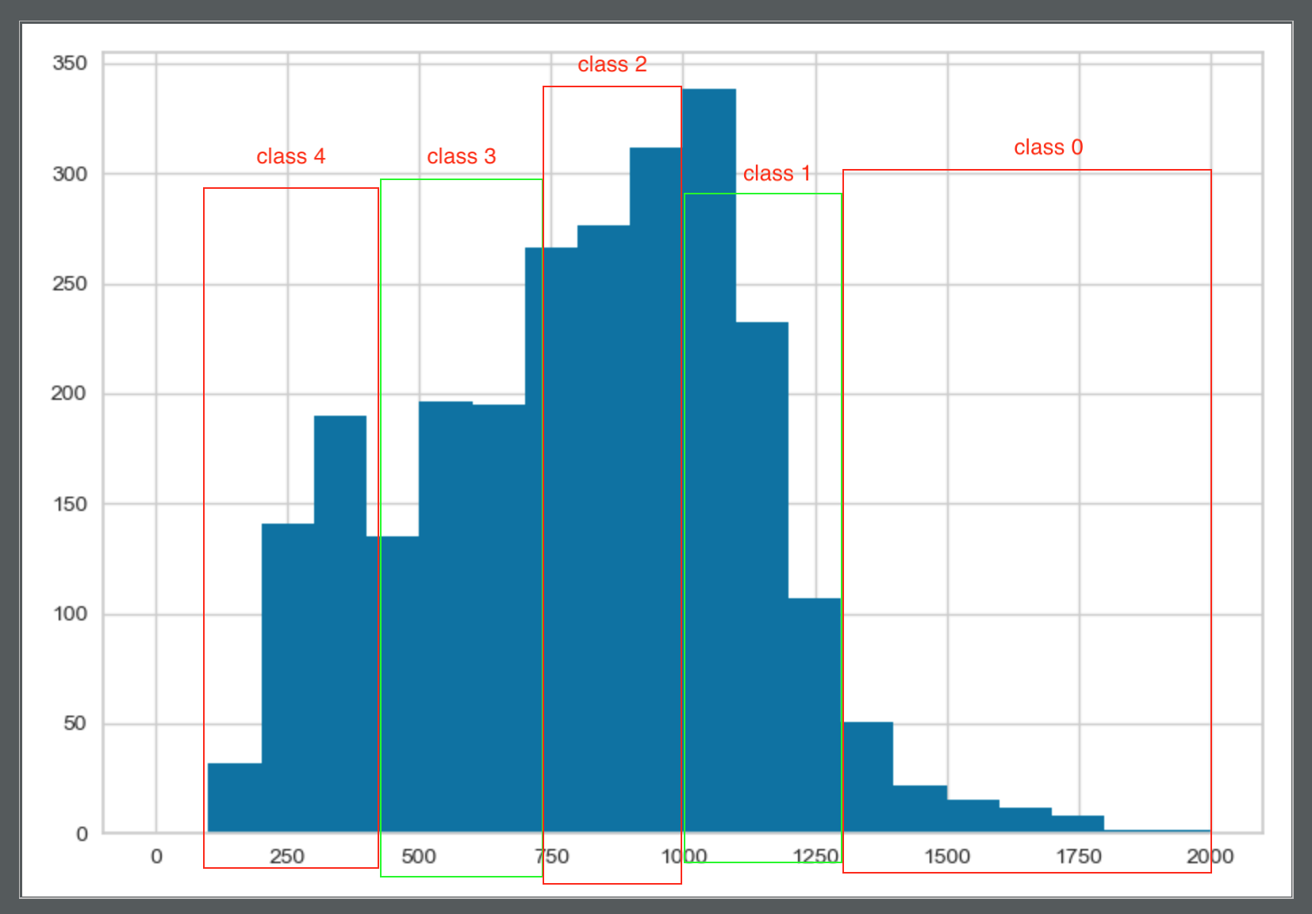
3.2 SUPERVISED LEARNING - CLASSIFICATION
Find Input and Output
-
We use the result of clustering in the previous step as a new parameter called "topic category", which represents the topic category to which the video belongs. In addition, we divide the three attributes of comment quantity, view quantity and duration according to the histogram, and change them from continuous variables to discrete variables, so that they can be used in classification. We decided to use the subject, comment volume, and duration as input to get a classfication of views.

Slide 36
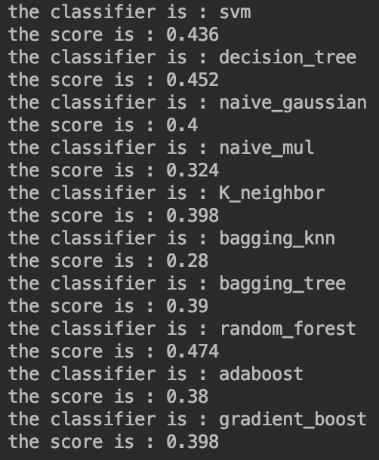
3.2 SUPERVISED LEARNING - CLASSIFICATION
Select Classification Algorithm
-
We used 500 of the more than 2,000 data as a test set. Through the training set, we used different algorithms to obtain the classification model results and scored the results. The results are as follows.
From the scoring we can see that the Random Forest score is the highest for the integration method, and the Bagging Knn algorithm, which is also the integration method, has the lowest score. Therefore, our classification decided to use the Random Forest algorithm.

Slide 37
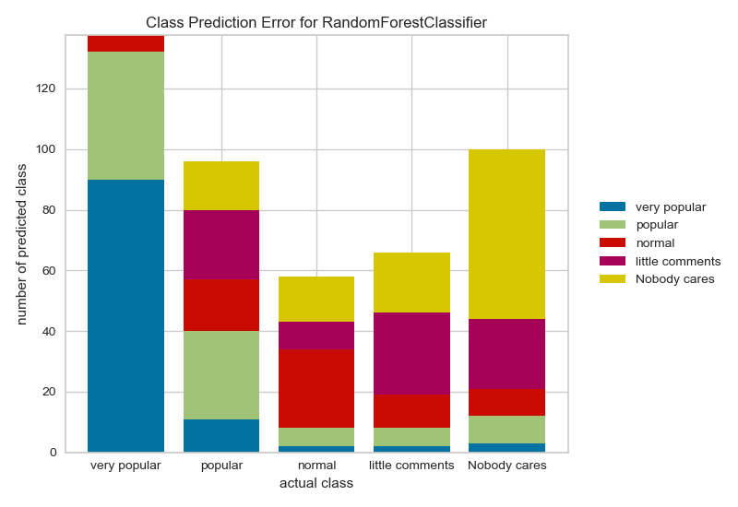
3.2 SUPERVISED LEARNING - CLASSIFICATION
Test Results
-
We use the Random Forest algorithm for classification, and then for the result test, we get the Prediction Error Figure and Confusion Matrix obtained by this algorithm classification.
The class prediction error chart provides a way to quickly understand how good our classifier is at predicting the right classes.

Slide 38
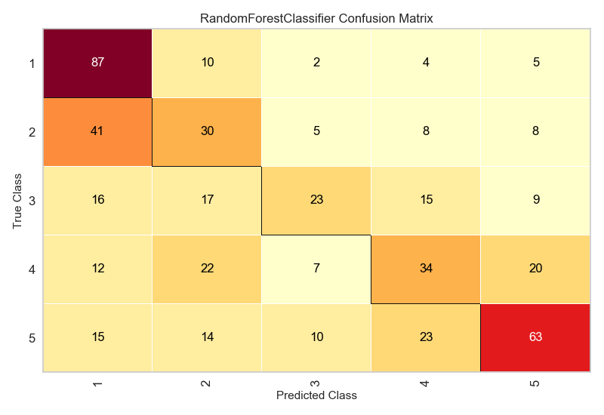
3.2 SUPERVISED LEARNING - CLASSIFICATION
Test Results
-
A ScoreVisualizer that takes a fitted scikit-learn classifier and a set of test X and y values and returns a report showing how each of the test values predicted classes compare to their actual classes.
We use confusion matrices to understand which classes are most easily confused.

Slide 39
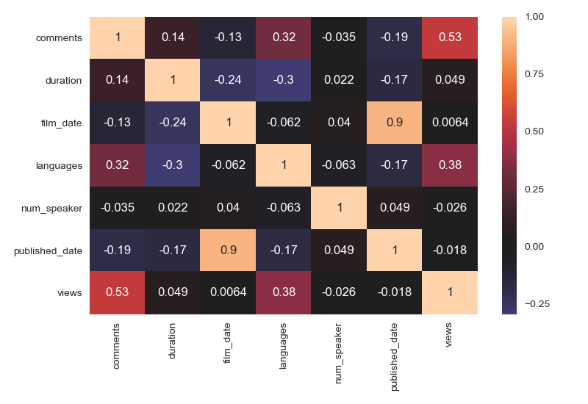
3.3 SUPERVISED LEARNING - REGRESSION
Looking for Relevance
-
We used Heatmap to represent the relationship between the various numeric attributes.
We can see that there is not much strong correlation between other attributes except for the obvious positive correlation (0.53) between views and comments. This also proves that we may not be able to produce perfect predictions, but we can try to make a regression. We ended up using duration, language and views to make regression predictions on comments.

Slide 40
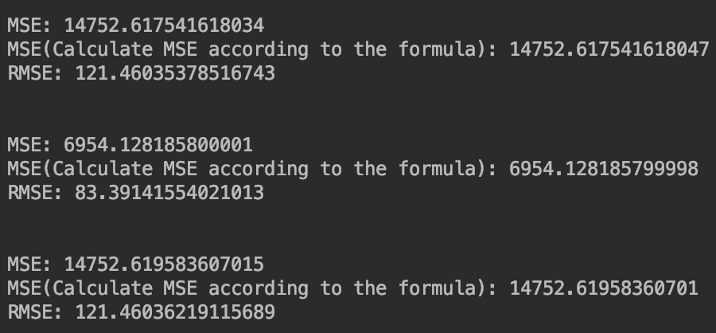
3.3 SUPERVISED LEARNING - REGRESSION
Try Different Regression Algorithms
-
In order to get relatively good regression results, we tried three algorithms: linear regression, ridge regression and random forest algorithm. Their results are as follows:
We can see that the random forest algorithm in the middle obtains the smallest RMSE deviation, while the results of linear regression and ridge regression are not much different, and the results from the random forest algorithm have large errors. Therefore, we decided to use the random forest algorithm for regression prediction in the project.

Slide 41
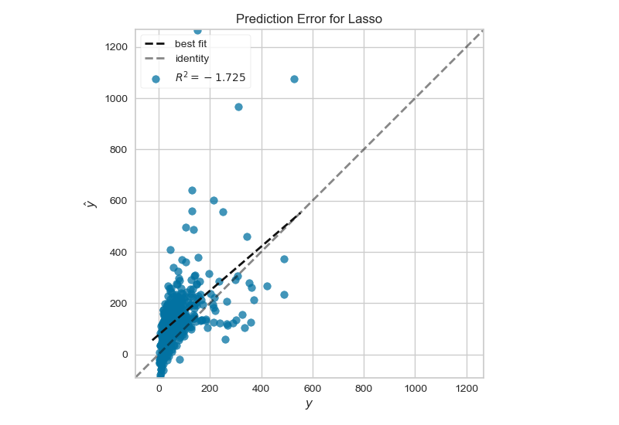
3.3 SUPERVISED LEARNING - REGRESSION
Deviation analysis
-
Lasso is a biased estimate of sparse data that minimizes the value of MSE under sparse data.
Our data is almost concentrated near a straight line at a 45-degree angle, but the predicted values are a little larger than the true value. As you can see from the figure, the Lasso algorithm is more suitable for our sparse, irrelevant data, but because it is a biased estimate, we can't use it in real prediction.

Slide 42
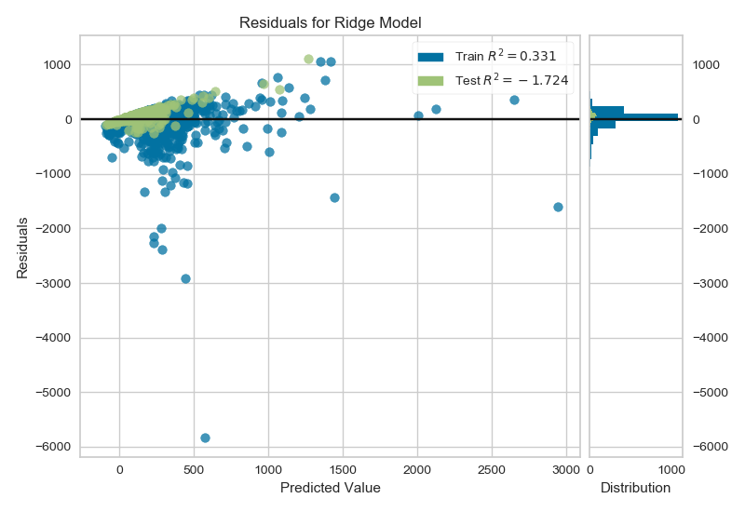
3.3 SUPERVISED LEARNING - REGRESSION
Deviation analysis
-
Our training data is a blue point, and the test data is a green point. This figure shows the residuals between the test data and the training data. We see that the residuals of most of the test data are clustered around 0, indicating that our training model is more realistic.

Slide 43
Step 4
Architecture & Test

Slide 44
This is a project flow chart mentioned earlier, which briefly introduces the overall framework and front-end interaction.

Slide 45
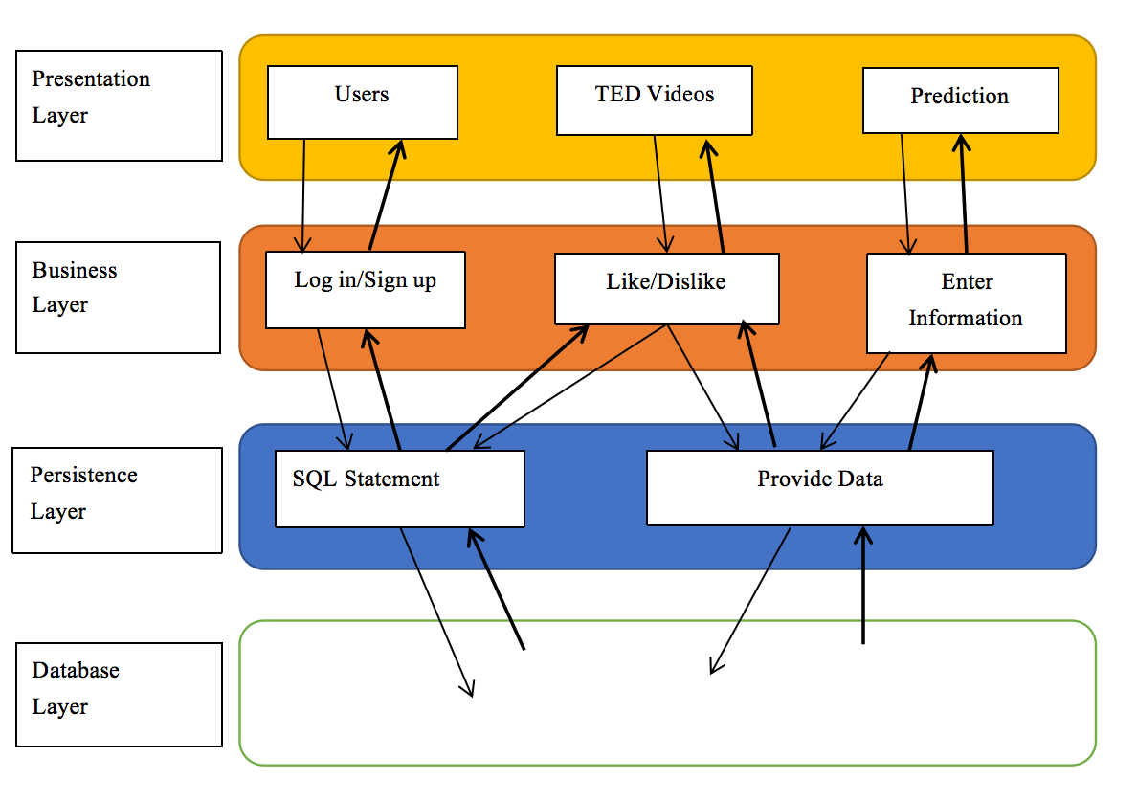
The hierarchical architecture of our project is shown in the figure. The whole is divided into four layers: presentation, business, business and database.
When the user enters our website, they need to click the button to register and log in. The front end will pass the operation to the backend to activate the corresponding function and SQL statement to access the database for data storage and return the data to the front end for user interaction.
For the user to use the prediction function, after inputting the information, the information is transmitted to the corresponding algorithm to call the corresponding algorithm, and the calculated result feedback is displayed in the webpage information box.
The process for selecting a TED video for the user according to preference is similar to the above two.

Slide 46
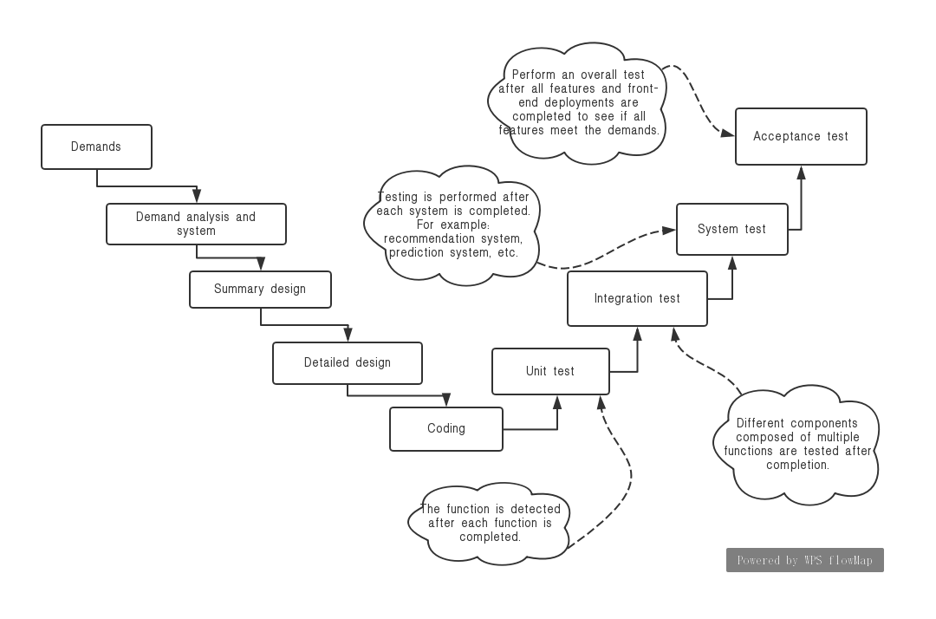
The figure of test flow

Slide 47
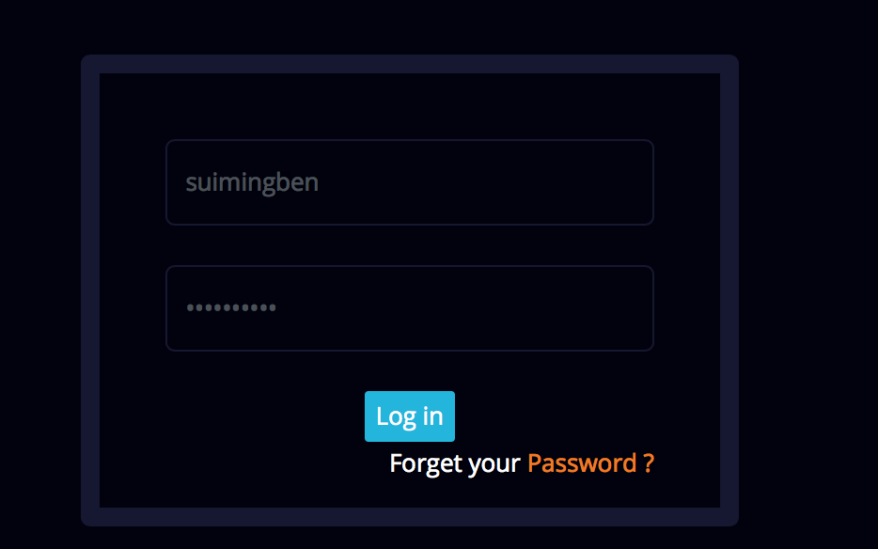
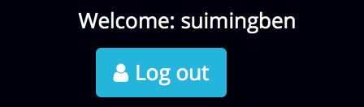
After we have registered the account, enter the account password and display the text in the upper right corner of the web and you can access the personal homepage to prove that the registration and log in function is normal.

Slide 48
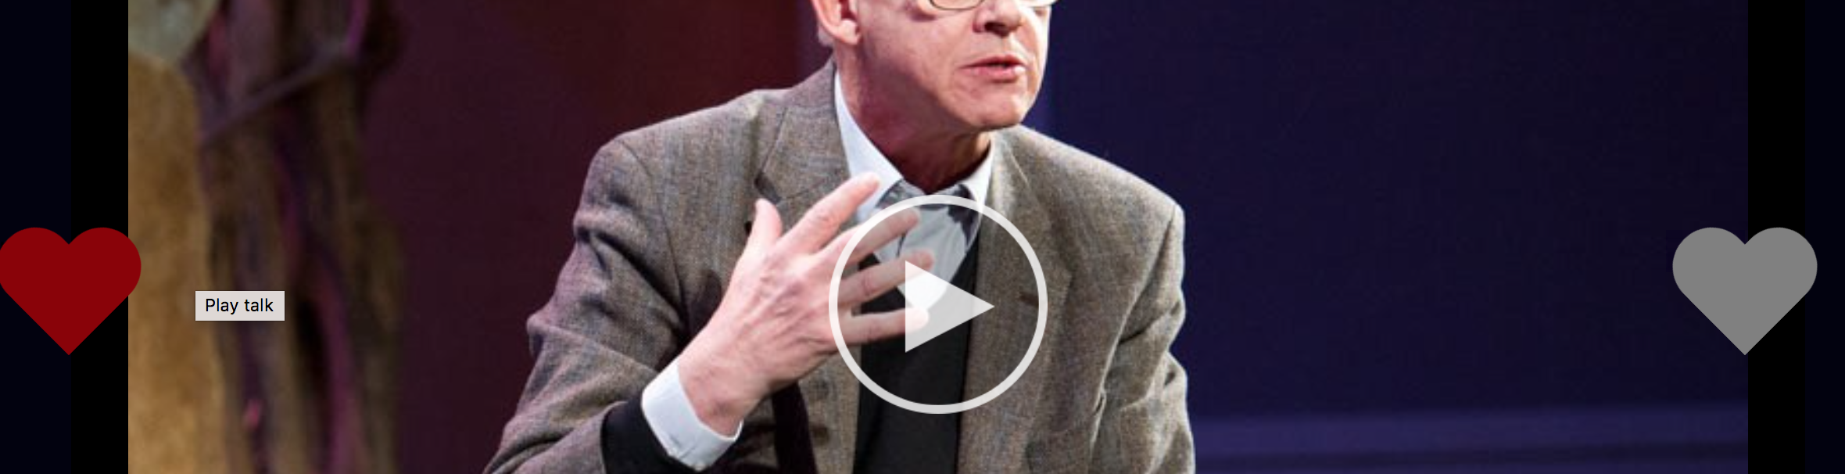

When the user clicks the like button, the video can be replaced normally, and the profile of the user who likes the TED video is displayed on the personal homepage, which proves that the recommendation system is normal.

Slide 49
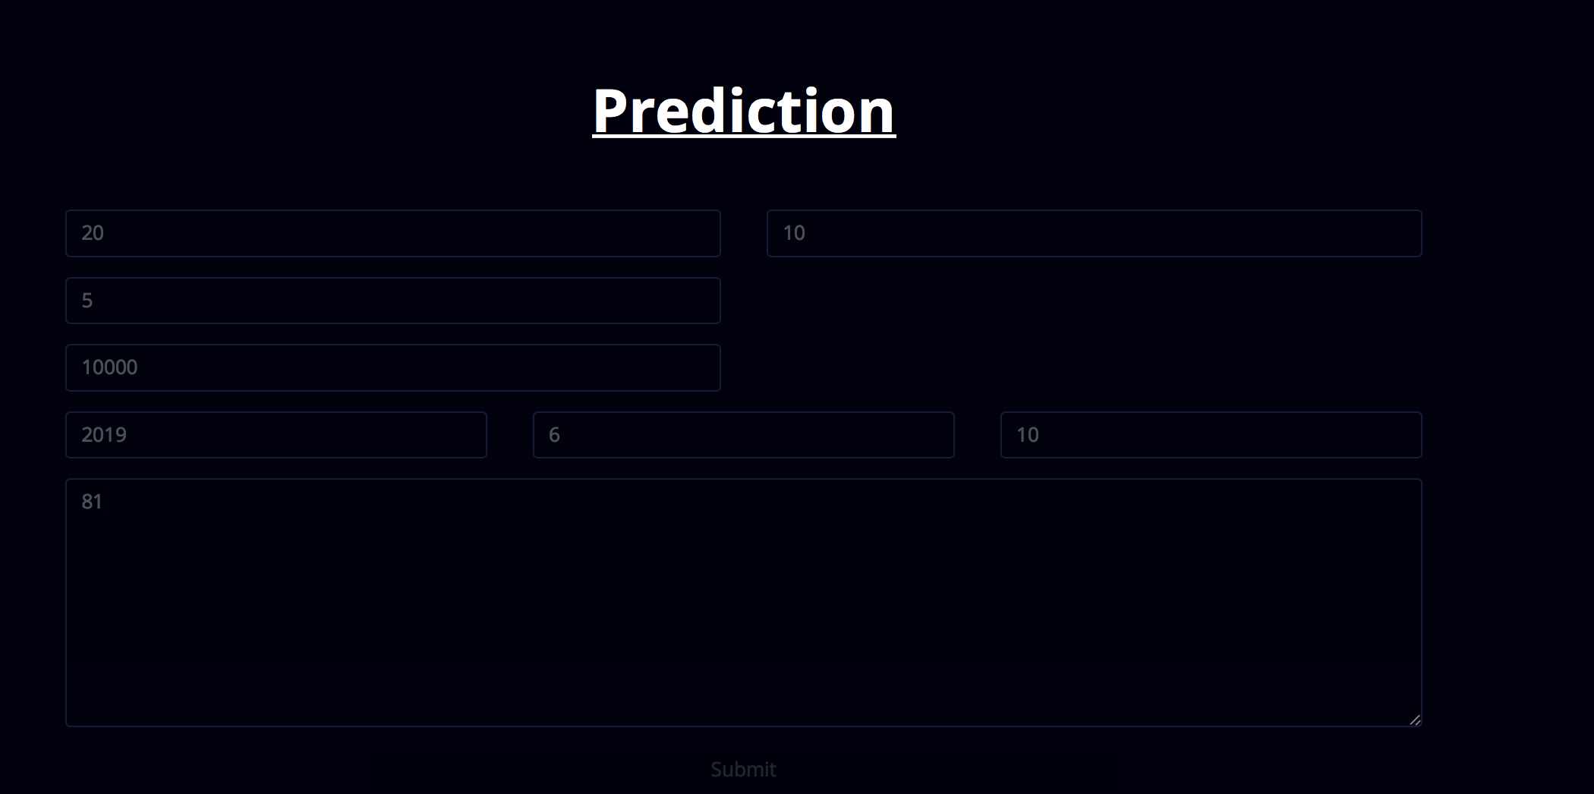
When the user tries to predict the function, enter different data and click the submit button, the website can display the corresponding different data, and the results of these data are consistent with the predicted data graph.

Slide 50
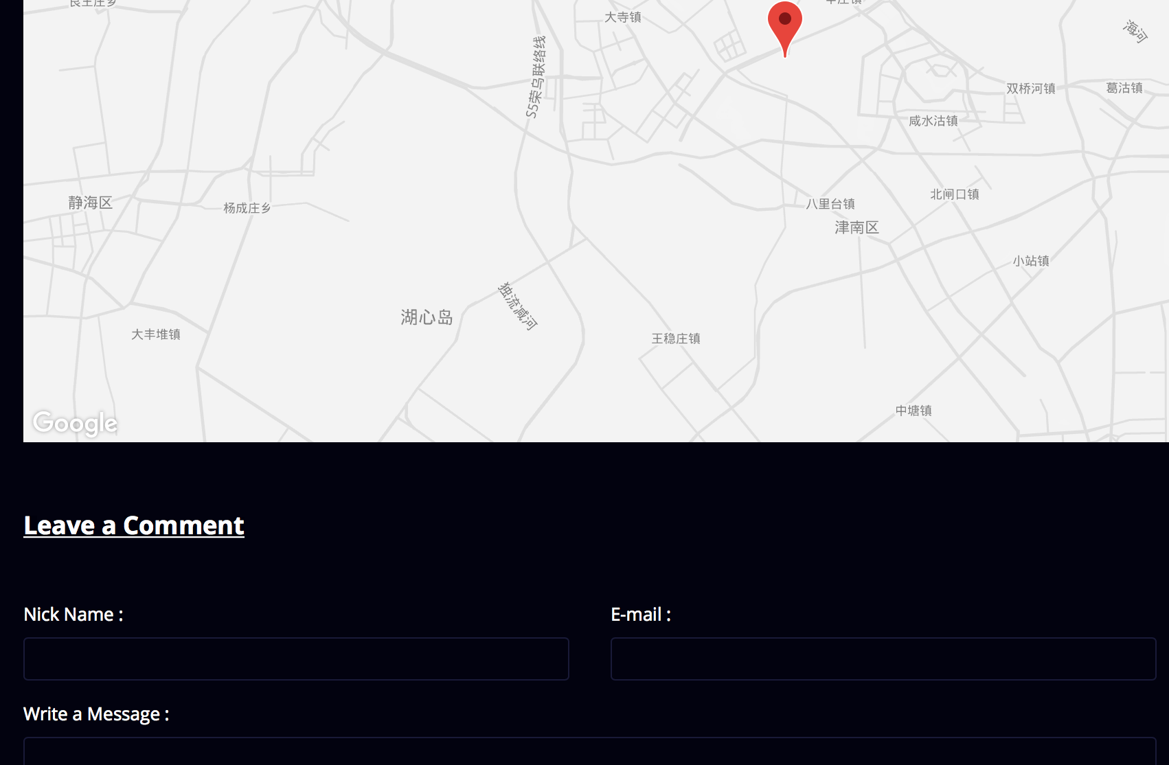
This feature is normal when the user can get a dynamic Google map and can enter a message to our team and the prompt is sent successfully.
If all the functions are working properly, the test is successful.

Slide 51
5
Conclusion

Slide 52
5 Conclusion
What We Have Done
Three kinds of ways of ML.
A webpage that can complete recommendations and predictions.
Documents to explain our application.
To Be Improved
1. More complete data processing.
2. More efficient machine learning algorithm.
3. Separation of the front and back of the webpage.
Notes:
Dimensionality reduction 降维
Singular Value Decomposition 奇异值分解
Filter data to reduce useless or extreme data
A machine learning method that better fits the characteristics of our dataset
Standardize

Slide 53
Thanks for Watching

